Slide 1
Intro to Execution Plans
For Evaluating Query Performance
Supporting Database Lab Experiments
Parallelism
Join Hints

Slide 2
Execution Plans
Query Performance
Strategy and Choices in Table Design and Query Design

Slide 3
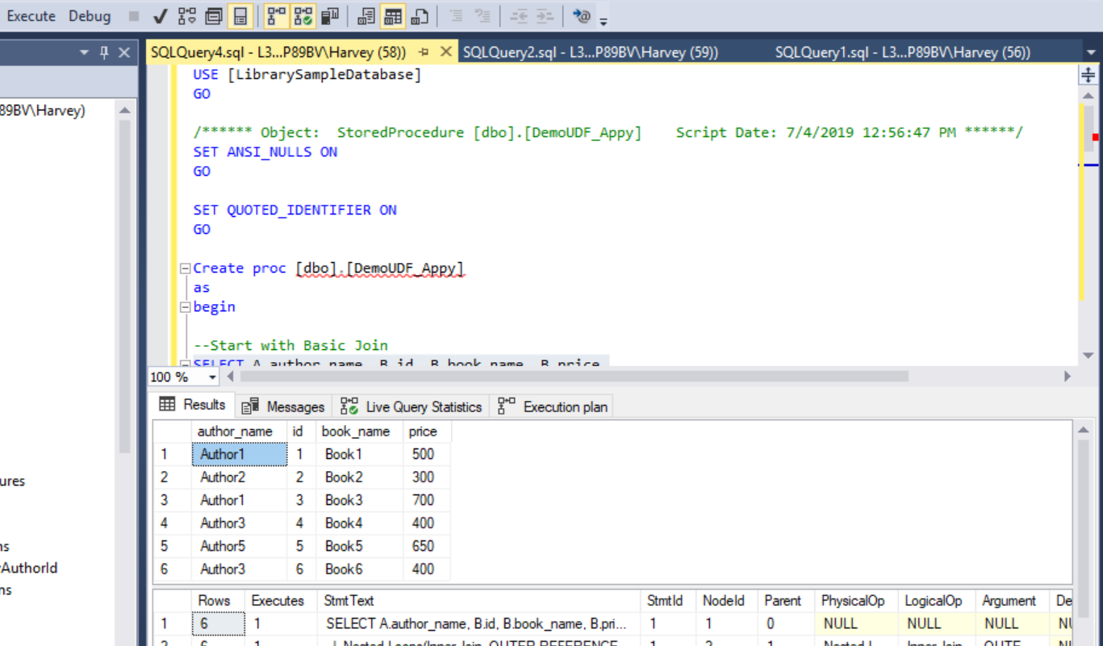

Slide 4
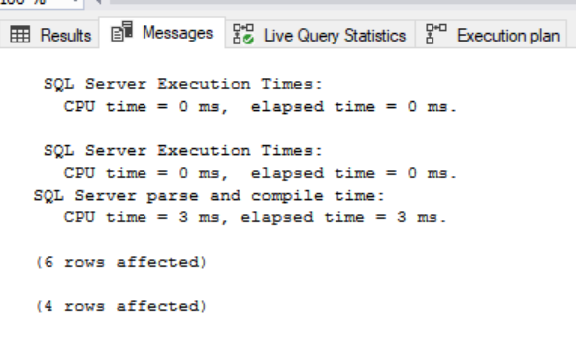
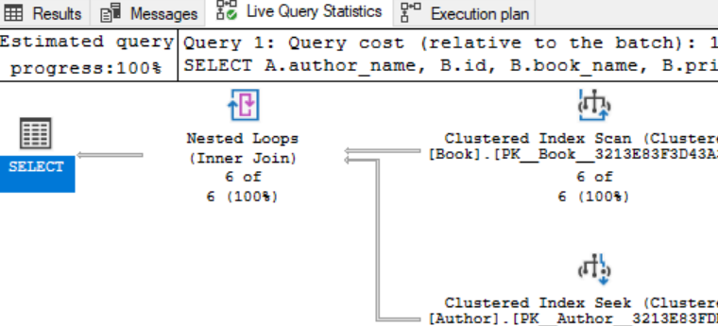
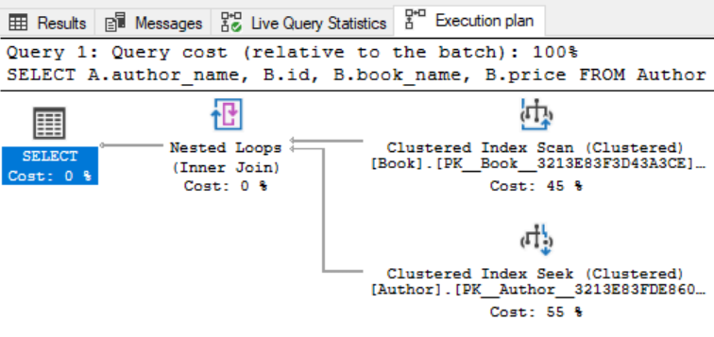
Performance Evaluation of Query Design and Execution

Slide 5
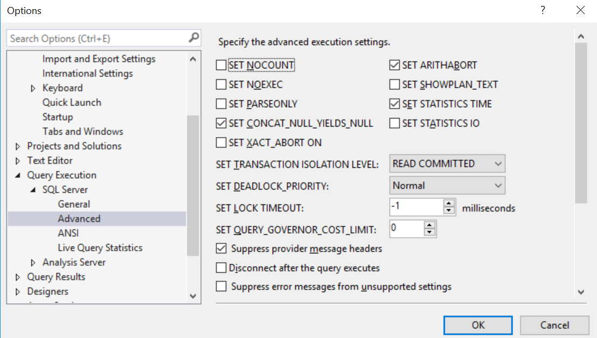
Option Settings

Slide 6
Parallelism
Splitting a query into separate operations to make it run faster.
“Query Optimizer” will make determination whether better to run serial or parallel.
You can manually manipulate this decision:
Server Properties: Set max split for processing.
Query Hints and Overrides: Specify how you want the query processed.

Slide 7
Parallelism: Walk through example experiments
https://www.mssqltips.com/sqlservertip/5404/parallelism-in-sql-server-execution-plan/
https://www.sqlshack.com/use-parallel-insert-sql-server-2016-improve-query-performance/

Slide 8
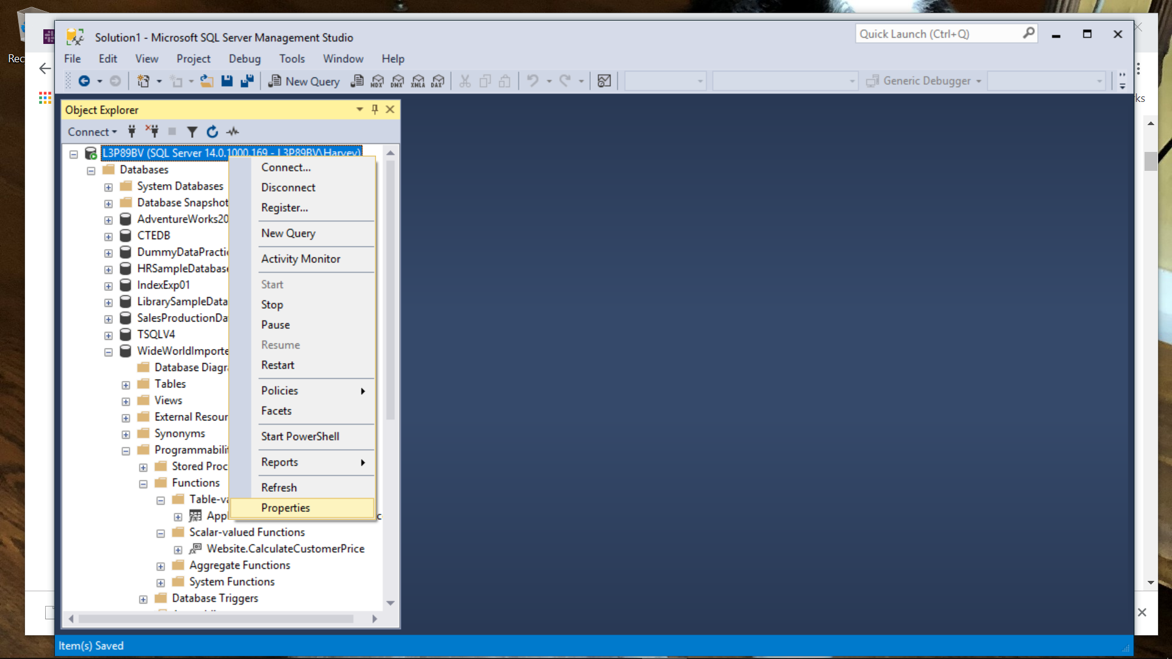
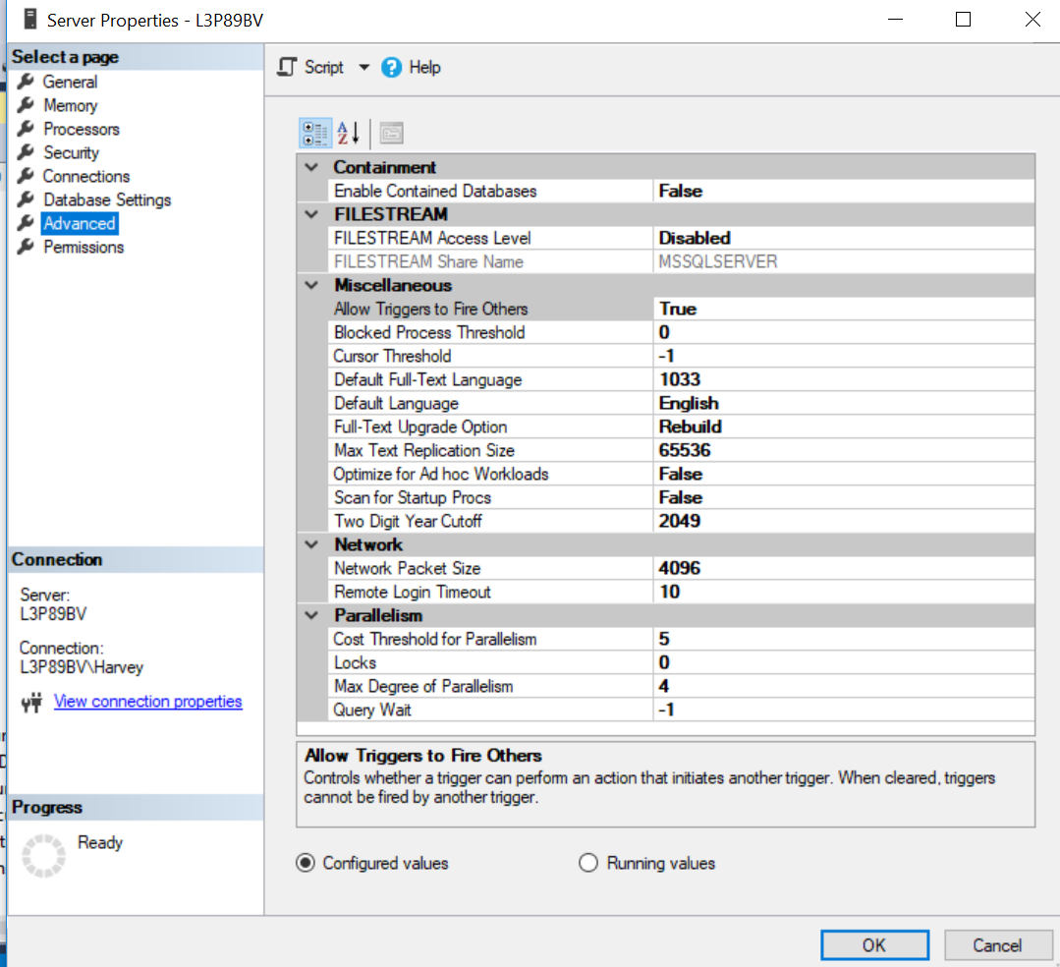
EXEC sp_configure 'max degree of parallelism', 4;
RECONFIGURE WITH OVERRIDE;
EXEC sp_configure 'max degree of parallelism'

Slide 9
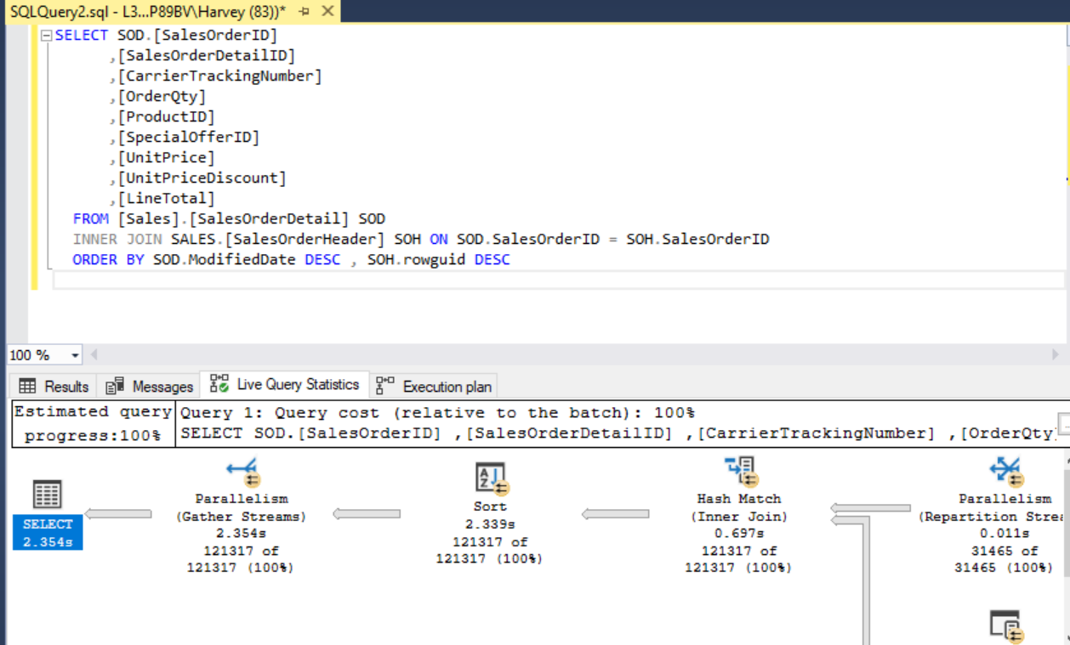
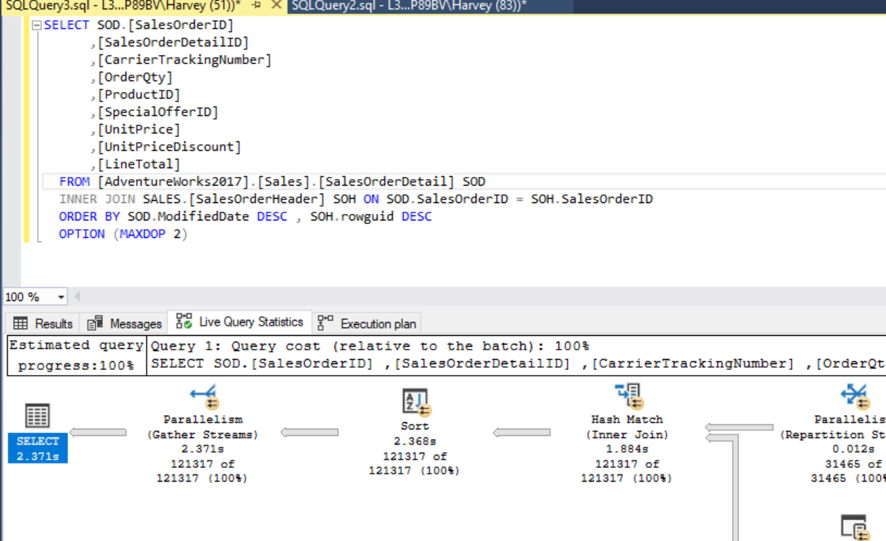
Example with AdventureWorks

Slide 10
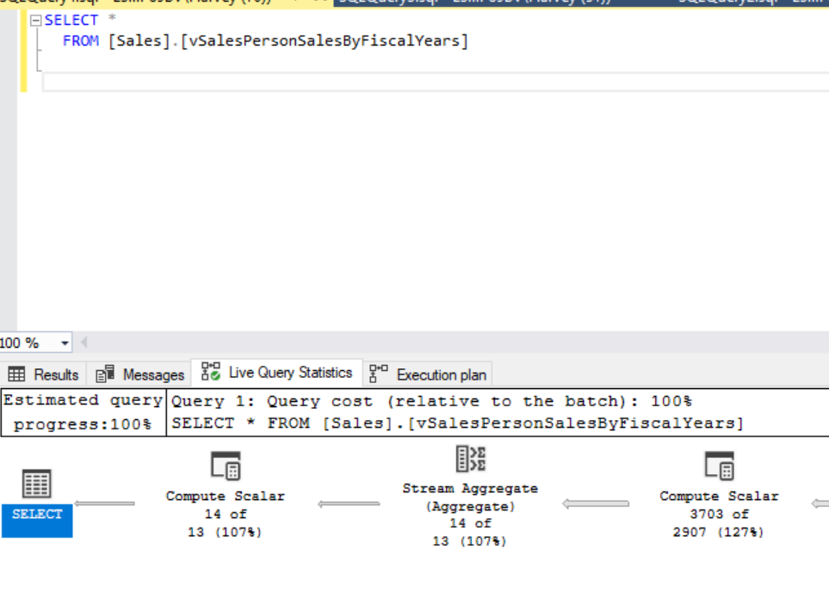
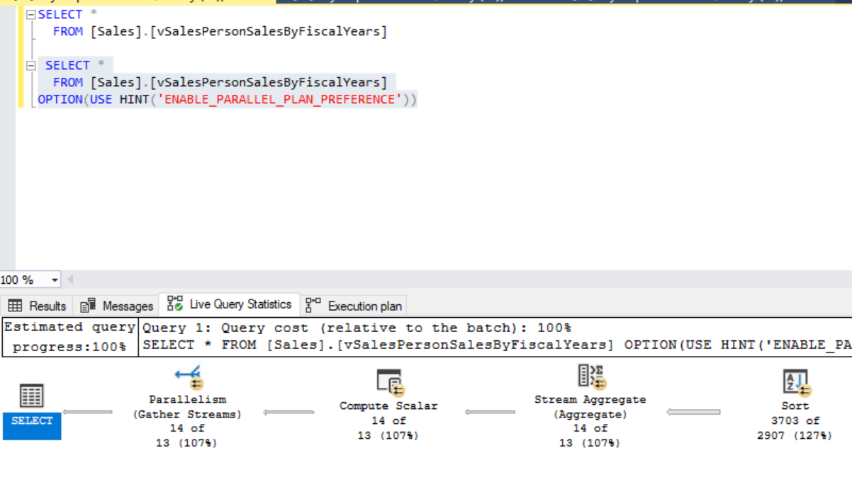
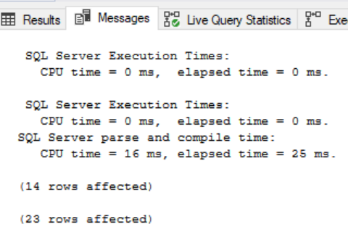
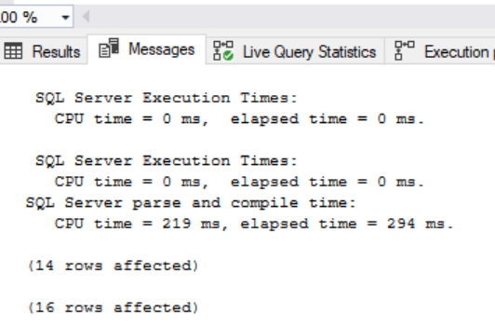
Option Use Hints

Slide 11
Join Hints: DBA “Tuning” Strategy
For manipulating how SQL Server processes the join operation in your query.
Syntax:
Full Explanation with a walkthrough example of why SQL DBA might choose different method for join operation:
https://www.mssqltips.com/sqlservertip/2917/sql-server-join-hints/
<join_hint> ::=
{ LOOP | HASH | MERGE | REMOTE }

Slide 12
Join Hints: Documentation and Walkthrough using AdventureWorks
https://docs.microsoft.com/en-us/sql/t-sql/queries/hints-transact-sql-join?view=sql-server-2017

Slide 13
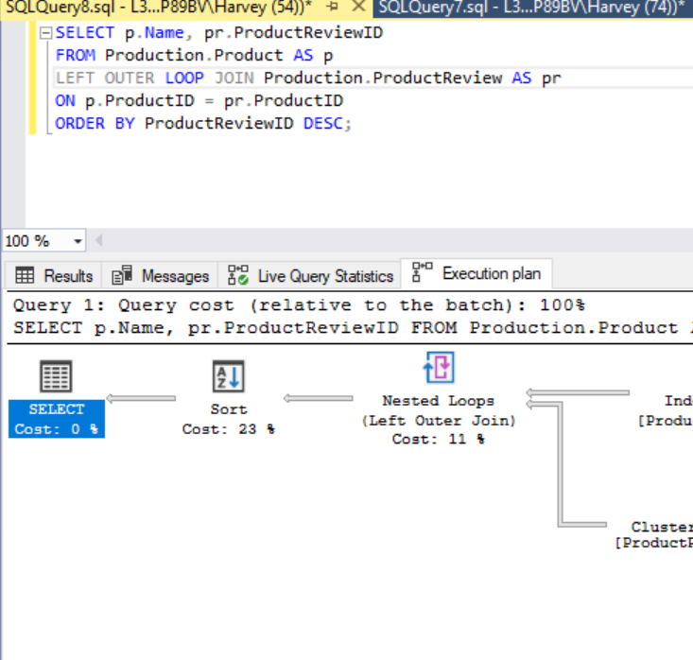
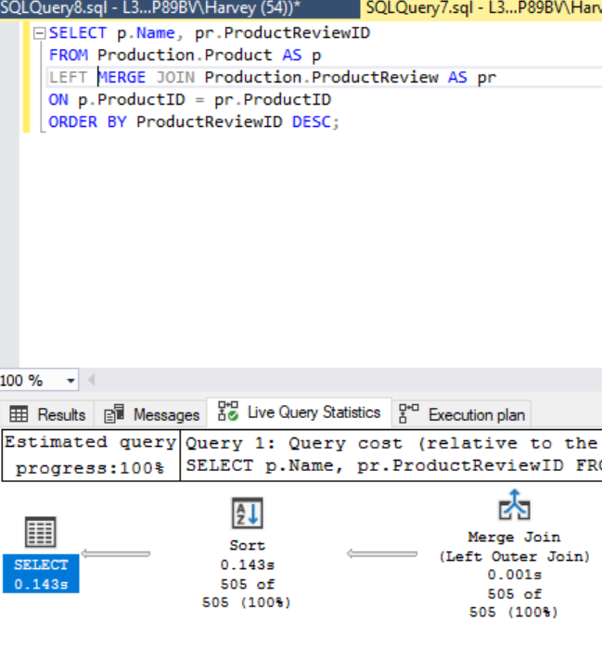
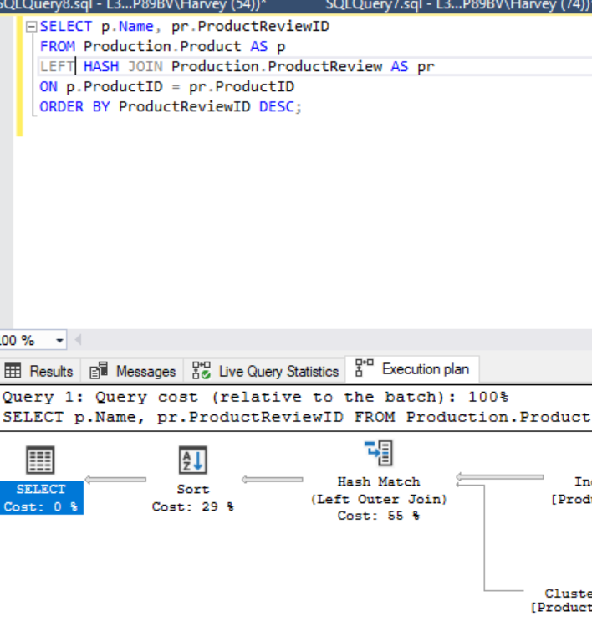
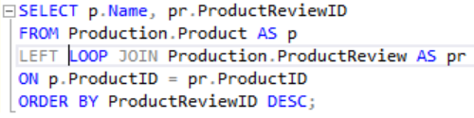
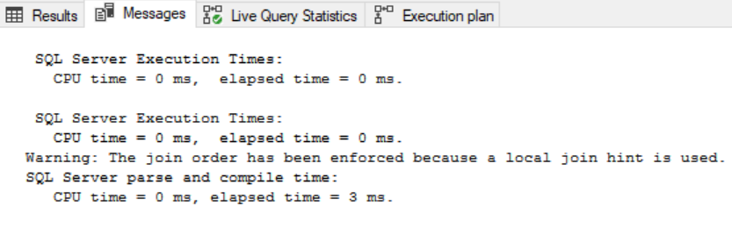
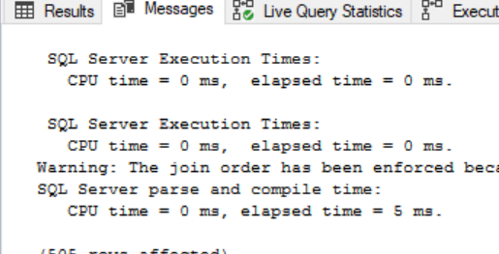
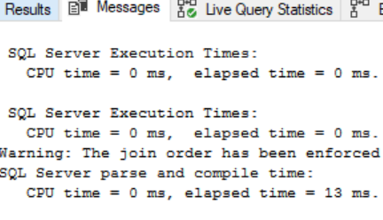
Compare Hash, Loop, Merge

Slide 14
Remote Join Hint
https://docs.microsoft.com/en-us/sql/t-sql/queries/hints-transact-sql-join?view=sql-server-2017
Specifies that the join operation is performed on the site of the right table. This is useful when the left table is a local table and the right table is a remote table. REMOTE should be used only when the left table has fewer rows than the right table.
REMOTE can be used only for INNER JOIN operations.
** - Do not confuse “right table” with “right outer join.”
** - See example on next slide.

Slide 15
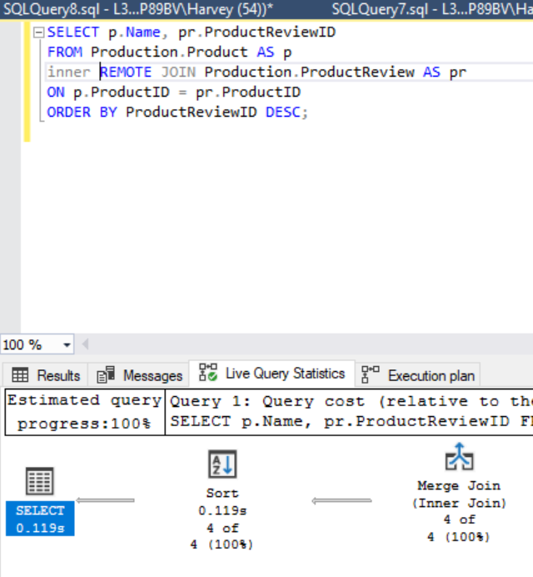
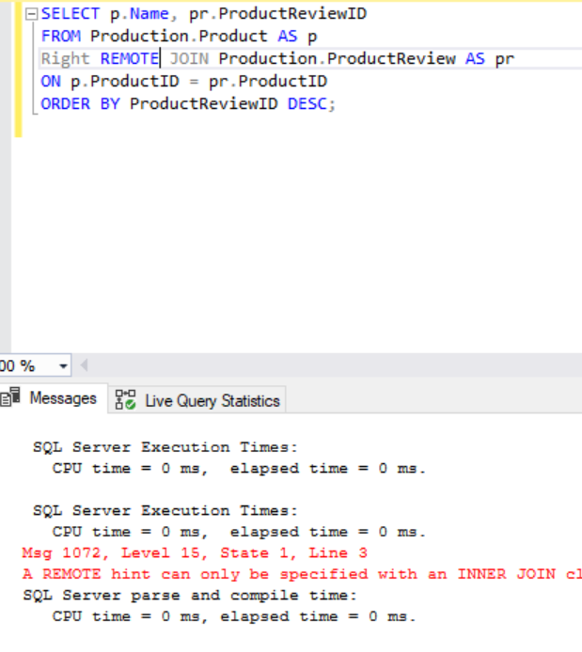
Must Use “inner” keyword Cannot Use on Outer Join

